Slide 1

HISTORY OF FREE
AND
OPEN SOURCE SOFTWARE
VAIBHAV KOKARE
F.Y BSC COMPUTER SCIENCE

Slide 2

WHAT WE WILL LEARN
1] INTRODUCTION
2] WHO AM I?
3] HISTORY
4] FEATURES
5] USERS
6] CONCLUSION

Slide 3
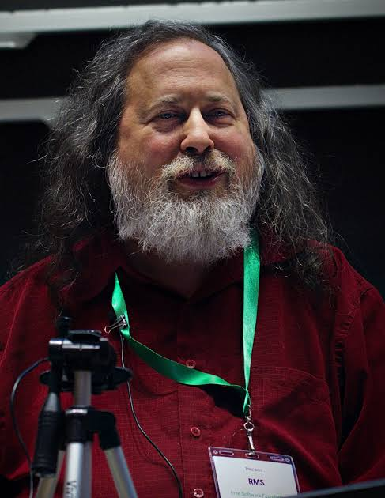
WHO AM I?
Richard Matthew Stallman
Born: March 16, 1953 (age 69) New York City, New York, US
Education: Harvard University Massachusetts Institute of Technology
Occupation: programmer
Website: stallman.org

Slide 4

HISTORY FLOWCHART
1950 SOFTWARE WERE FREELY SHARED
CONSIDERED SOFTWARE MEARLY A TOOL FOR ENABLING SALE
OF HARDWARE
1960 IBM CONSIDERED SELLING OF SOFTWARE
1970 SOURCE CODE WAS REMOVED FROM UNIX DISTRIBUTION AND
COULD ONLY BE ACCESSED BY PAYING
A LARGE SUM OF MONEY TO AT&T
1980 RICHARD STALLMAN PREACHED THAT SOFTWARE BE
FREE (OPEN SOURCE)

Slide 5
FACTS
First open Software
A-2 system
Most invaluable
open source software
Linux
140% increase intrest in buying open source softwares

Slide 6
USERS
WORLDWIDE USERS
Current users : 52.21 millions
INDIAN USERS
Current users : 7.2 million

Slide 7



WHAT YOU LEARNED
WE RESEARCHES ON A GREAT PERSONALITY RICHARD STALLMAN
WE UNDERSTOOD THE HISTORY FOSS
WE GOT TO KNOW ABOUT COMMUNITIES

Slide 8
?
QUERIES

Slide 9
THANKS FOR LISTENING!
LEARN MORE

